Slide 1
Smart 3D Setup and Administration
Smart 3D 2014R1

Slide 2
Know your instructor
CHERISE PRIMM
About 3 years of experience working with Smart 3D
Specialization in Setup and Administration, Reference 3D, Interference Detection Service

Slide 3
Prerequisites for this class
Experience with Microsoft Windows Operating System architecture
Experience with Microsoft SQL Server 2008 or Oracle 11g database server administration
Knowledge of 3D Plant Design CAD Concepts

Slide 4
Agenda
Day 1
Introduction to Smart 3D (concepts, terminology)
System Setup
Project Hardware Sizing
Project Setup (Database Creation, permissions)
Day 2
Backup and Restore
Project Management (delete plants, delete catalogs, hierarchy icons, create catalog)
Plant Organization (Systems hierarchy)
Smart 3D Common Applications

Slide 5
Agenda (Cont’d)
Day 3
Optimization for Roles
Set Default colors
Model Data Reuse
Synchronize Model with Catalog
Database Maintenance
Database Integrity
Day 4
Error Logs and Memory monitor
Interference Checking Service
PDS project Reference
Point Cloud Reference
Reference 3D (R3D) Part I

Slide 6
Agenda (Cont’d)
Day 5
Reference 3D (R3D) Part II
Intergraph Batch Services
Database conversion wizard (SQL ORACLE)
Plant version upgrade

Slide 7
Smart 3D Introduction

Slide 8
Smart 3D - Database architecture
Plant Configuration
Site
Site Schema
Catalog
Catalog Schema
Model
Reports
Reports Schema
CDB
MDB
RDB
CDB
SCHEMA
RDB
SCHEMA
SDB
SDB
SCHEMA

Slide 9
Smart 3D - Database architecture
Plant Configuration
Site
Site Schema
Catalog
Catalog Schema
Model
Reports
Reports Schema

Slide 10
Smart 3D - Database architecture
Plant Configuration
Site database set:
Contains configuration and connection information and links the rest of the databases.
Catalog database set:
Contains the Reference Data used by all disciplines.
Store Design Modules (assemblies), Catalog Filters
Model database:
Contains and organizes all of the three-dimensional objects in the plant, referenced objects data.
Stores definition and content of deliverables (Drawings and Reports), Plant and user’s Filters, Styles, Surface Style Rules, etc.
Reports database set:
Optimize data retrieval from other five databases.
Catalog database set
Model
database
Reports
database set
Site database set

Slide 11
Smart 3D - Database architecture
Plant Configuration options
Catalog 1
Model 1
Report 1
Multiple Plants can share the same Catalog …
Site 1
Model 2
Report 2
Catalog 2
Model 3
Report 3
… or exclusively use own Catalog

Slide 12
Smart 3D - Database architecture
Plant Configuration options
Catalog 1
Model 1
Report 1
Multiple Plants can share the same Catalog …
Site 1
Model 2
Report 2
Catalog 2
Model 3
Report 3
… or exclusively use own Catalog
Notes:
12

Slide 13
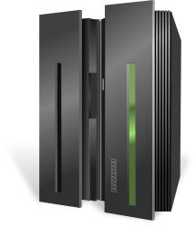


Smart 3D intro: Server - Client architecture
Database Server
- Name Generator
- SharedContent
Smart 3D Client
Interference Checking Server
Smart 3D Client
Batch Server
Ancillary servers

Slide 14

Smart 3D intro: Define Workspace
Filter on database
Returns only the data you want to see
and builds a logical “Working Set”
System
Assembly
Spatial (Volume or Planes)
Logical Permission Groups
Object Types/Properties
Reports Database set
Model Database
Site Database set
Catalog Database set
Workspace

Slide 15
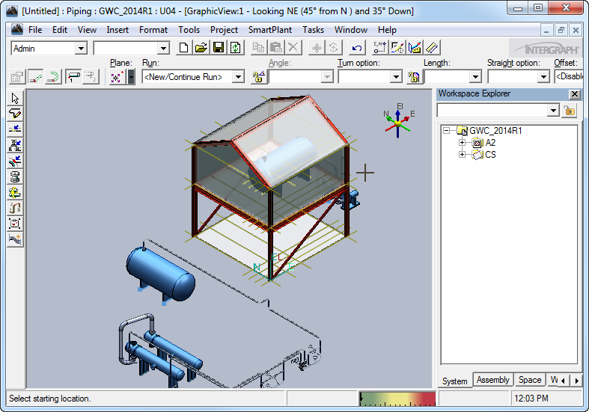
Smart 3D intro: Modeling environment
Discipline oriented interface
Drawings and Reports
Graphic views
Access
Control
Main Menu
Common Toolbar
Workspace
Explorer
Active
command Ribbon bar
Task Toolbar
Active View
To Do list meter
Status Bar

Slide 16
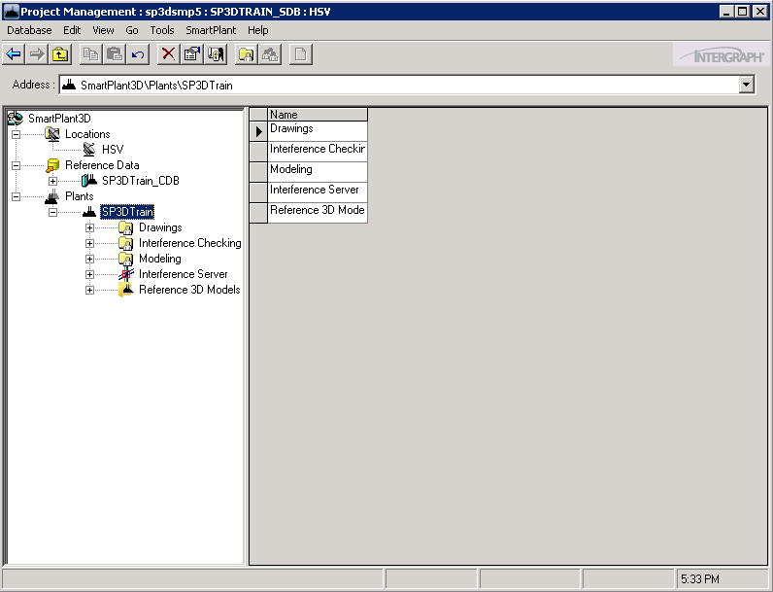
Smart 3D intro: Project Management
Create, backup and restore plants
Modify user accesses to model objects
Start/Stop Interference checking
Configure Global Workshare
Migrate databases
Main Menu
Tree view
List view
Permissions
Hierarchy

Slide 17
Smart 3D intro: Relationships and Integration
Smart 3D synchronizes key elements of integration and relationships.
Integration - Smart 3D allows multiple engineering disciplines to work concurrently and in real-time against relational databases.
Relationships - Smart 3D's relationship manager controls design changes across disciplines, which in turn establishes and maintains appropriate behaviors among structures, equipment, and systems.

Slide 18
Smart 3D intro: Administrative guides
Smart 3D Release Bulletin
Smart 3D Installation Guide
Smart 3D Installation Checklist
Smart 3D Project Management User's Guide
Smart 3D Database Integrity Guide
Smart 3D Global Workshare Guide
Smart 3D Interference Checking Guide
Smart 3D Troubleshooting Guide
Smart 3D Point Cloud Guide

Slide 19
System Setup

Slide 20
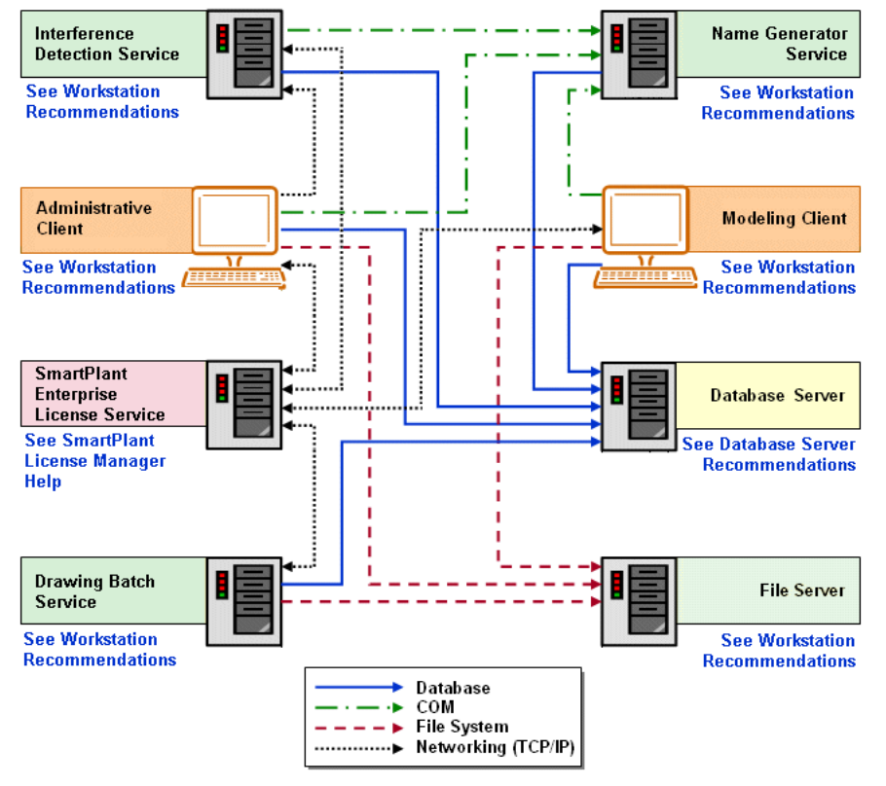

Slide 21
System Setup: Smart 3D servers
One or multiple server machines can be used to provide the following required supporting services:
Database server
Provides hosting services for the Smart 3D databases
Shared content file server
Contains support files for the Smart 3D project, symbol definitions, drawing and reports templates, reference files, translator data, etc.
Name Generator service provider
Generates object names and contains naming rules for object placement and certain administrative functionality

Slide 22
System Setup: Smart 3D ancillary servers
Ancillary servers are computers dedicated to perform a specific task with the purpose to offload processing from the main database server.
Interference checking (IFC)
Checks interferences between objects in the plant
Intergraph Batch services
Manages scheduling and execution for commands to be processed in batch mode

Slide 23
System Setup: Smart 3D workstation machines
Workstations connected to the database server
Administrative clients
Used in administrative and maintenance tasks such as backups, restores, bulkload to catalog, database maintenance and integrity checks, attaching external references, manipulations with large data (MDR)
Modeling clients
Contains all discipline related tasks and commands to create objects in a plant
Output clients
Contains all discipline related tasks and commands to create deliverables generated from plant

Slide 24
System Setup: Server - Workstation
Hardware recommendations
Supported platforms
Software prerequisites
Installation

Slide 25


System Setup: Hardware recommendations Database server
Intel Xeon® 5600 Series or better (64-bit instruction set, not Itanium®)
16 GB to 64 GB or greater RAM depending on project size
For hard drive size, see “Smart 3D Project Hardware Sizing Recommendations” in the Installation guide
Backup system for server
Access to DVD drive, either locally or through a network connection
1 GbE or higher network interface for client connections

Slide 26
System Setup: Supported platforms Database server
Supported Operating Systems
Microsoft Windows Standard/Enterprise Server 2008 R2 SP1 (64-bit)
Supported Database Servers
Microsoft SQL Server 2008 R1 Service Pack 3 (Standard edition for stand-alone environments; Enterprise edition for Global Workshare environments; 64-bit)
OR
Microsoft SQL Server 2012 (Standard edition for stand-alone environments; Enterprise edition for Global Workshare environments; 64-bit)
Available only after installing Smart3D 2014R1 HF05 or later

Slide 27
System Setup: Supported platforms (Contd) Database server
Oracle Database 11g Release 2 (11.2.0.2) with patch set # 22 (Standard edition for stand-alone environments; Enterprise edition for Global Workshare environments; 64-bit)
If you are going to use Oracle in a Global Workshare configuration, you also need Oracle GoldenGate 11.2.1.0.3, which is separately purchased from Oracle
OR
Oracle Database 11g Release 2 (11.2.0.4) (Standard edition for stand-alone environments; Enterprise edition for Global Workshare environments; 64-bit)
Available only after installing Smart3D 2014R1 HF05 or later

Slide 28
System Setup: Software prerequisites Database server
Software prerequisites
Adobe Reader or equivalent PDF reading software
Microsoft XML Core Services (MSXML) 6.0 (Database server only)
Microsoft .NET 4.0 (Database server only)

Slide 29
System Setup: Installation of Smart 3D Reference Data – Name Generator
Reference Data
Shared Content files
Database Templates
Oracle initialization scripts
Name Generator
COM+ Application
Launch Setup.exe and after agreement to the Software License Agreement terms and conditions select applicable options like e.g. “Reference Data Installation” for the Smart 3D Reference Data server software load or “Name Generator” for the Name Generator installation

Slide 30
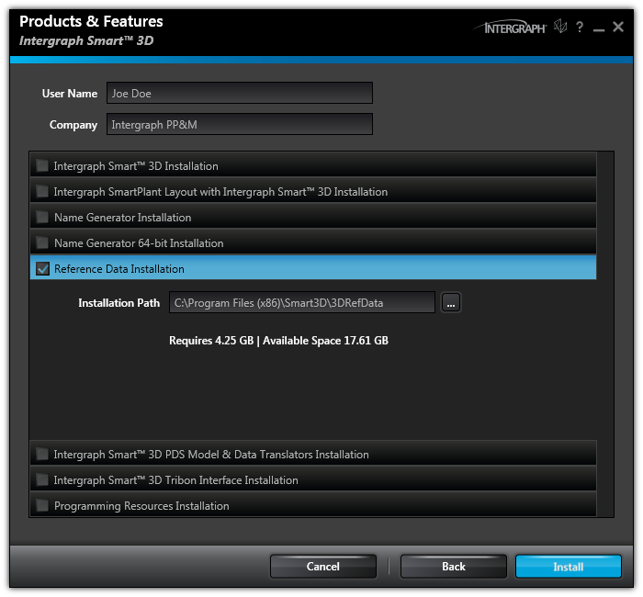
System Setup: Installation of Smart 3D Reference Data

Slide 31
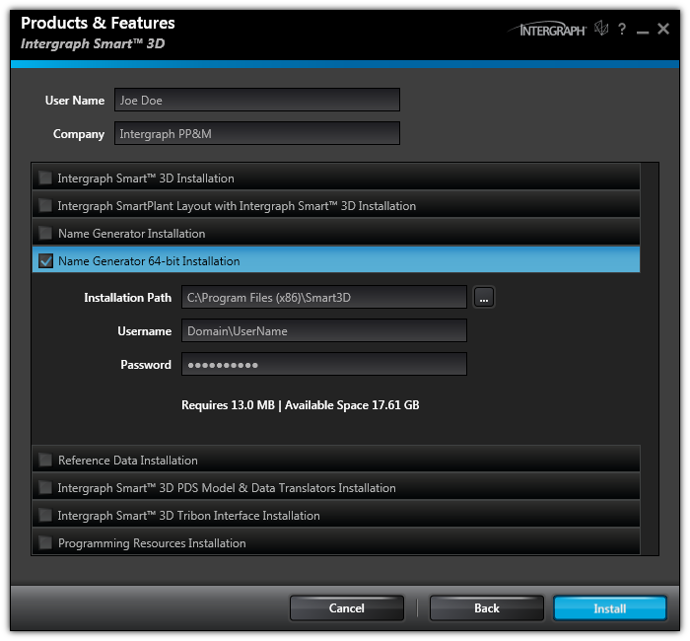
System Setup: Installation of Smart 3D Name Generator

Slide 32

System Setup: Installation of Smart 3D Workstation
Applicable configurations
Administrative Client workstation
Modeling Client workstation
Interference Detection computer/server
Drawing Batch computer/server
Duplication and Synchronization computer
Smart 3D Piping Specification Remote computer

Slide 33
System Setup: Hardware recommendations Workstation
Intel Core i7, Quad Core
6+ GB RAM
Access to a DVD drive, either locally or through a network connection
Monitor capable of a minimum of 1280 x 1024 resolution
1 GbE network interface
Graphics card designed for 3D intensive applications that meet the following requirements:
32-bit main RGBA pixel buffer
Hardware OpenGL 2.1 support
Hardware Z buffer: 24 bit or higher
256 MB RAM
8-bit stencil buffer
Hardware Alpha blending support
Graphics acceleration set to full
Hardware Anti-aliasing support recommended
Latest available drivers should be installed

Slide 34
System Setup: Supported platforms Workstation
Supported Operating Systems and required service packs
Microsoft Windows 7 Professional or Enterprise SP1 (64-bit)
Microsoft Windows Server 2008 R2 (64-bit) only as a client for Citrix XENDesktop 7.0
Supported database clients and required versions
Microsoft SQL Server 2008 R1 client SP3 (32-bit or 64-bit)
Microsoft SQL Server 2012 (32-bit or 64-bit)
Oracle 11g Release 2 client 32-bit
11.2.0.2 with Patch set # 22 OR
11.2.0.4 (After installing V2014 R1 HotFix05)
Oracle 11g Release 2 Client 64-bit - only applicable with Smart 3D 64-bit services (IFC and Drawings Batch)
11.2.0.2 with Patch set # 22 OR
11.2.0.4 (After installing V2014 R1 HotFix05)
NOTE: Oracle “Light Client” will not work

Slide 35
System Setup: Software prerequisites Workstation
Software prerequisites
Microsoft Internet Explorer 9.0
Adobe Reader 9.0 or higher (or equivalent PDF reader software)
Microsoft XML Core Services (MSXML) 6.0 SP1
Microsoft .NET Framework 4.0
Microsoft Office 2010 (32-bit only)
SmartPlant License Manager 11.0 or later
Notes:
35

Slide 36
System Setup: Optional software Workstation
Intergraph Smart 3D Schema Component 2014R1 (05.01.00.0018)
Allows publishing to SPF or 3D Model generation
Intergraph Batch Services 06.01.08.00
Allows scheduling commands for batch and/or remote processing
PDS Data Access components
Allows referencing or export of PDS Projects
Solid Edge Version 20 or ST3
May be used for creating equipment symbols
Visual Basic 6 with SP6 (Visual Studio 2008 for .NET API)
Allows creation of graphic visual basic symbols, macros, custom rules, etc.
Point Cloud vendor software
Allows referencing Point Cloud projects in SP3D
Notes:
36

Slide 37
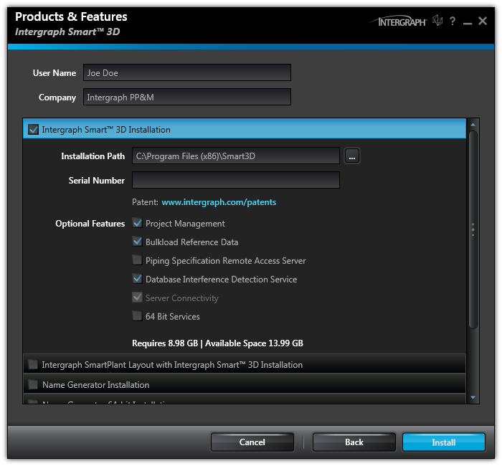
System Setup: Installation of Smart 3D Design /Admin Client Installation
Launch setup.exe and select “Smart 3D Installation” for the Smart 3D workstation setup.

Slide 38
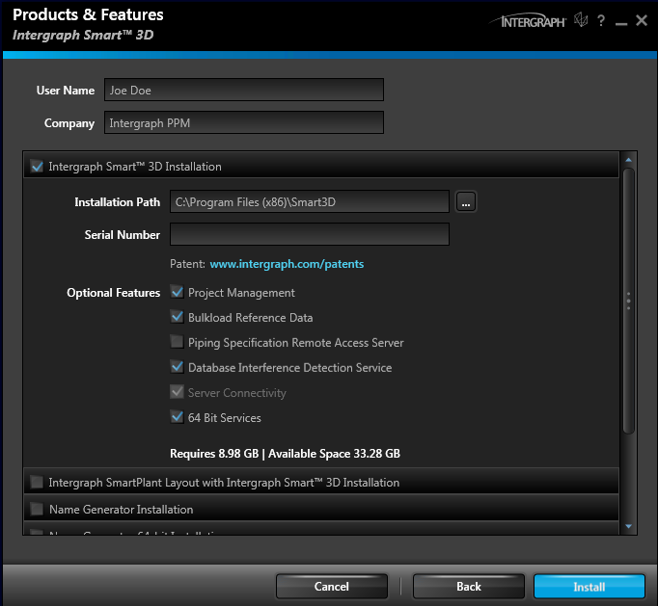
System Setup: Installation of Smart 3D 64-bit Services
64-bit Services can be used for IFC service and/or Drawing Batch Services
These cannot be uninstalled individually, need to uninstall Smart 3D software.

Slide 39
Smart 3D Setup

Slide 40
Smart 3D Setup
Software versioning is based on the different releases.
RTM - Release To Manufacturing (CD/DVD)
Service Packs
HotFixes
Current version: Smart 3D 2014R1 (10.01.15.0060)

Slide 41
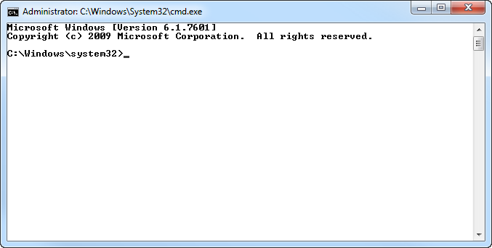
Smart 3D Setup: Silent Install
Smart 3D Can be installed through command line
Ideal to reduce deployment and maintenance impact
Service Packs or Hotfixes support silent install

Slide 42
Smart 3D Setup: Silent Install
S3DInstallation.exe SERIALNUMBER=### SLAACCEPT=YES [INSTALLDIR=<Path>] [X64SERVICES=Yes] [ADDLOCAL=Feature1,Feature2] [REMOVE=Feature1,Feature2]

Slide 43
Smart 3D Setup
Three different ways to configure Smart 3D.
Server
Name Generator
Shared Content
Workstation
Project Management
Bulkload
IFC…
Standalone

Slide 44
Smart 3D Setup
Before Installing…
Use an account with administrative privileges.
If installing under Windows 7 or Windows 2008, execute setup.exe with the option “Run as Administrator”
Verify that all prerequisite software was installed.
Don't skip any restart recommended by the software.
Verify Name Generator server is configured for MSDTC.

Slide 45
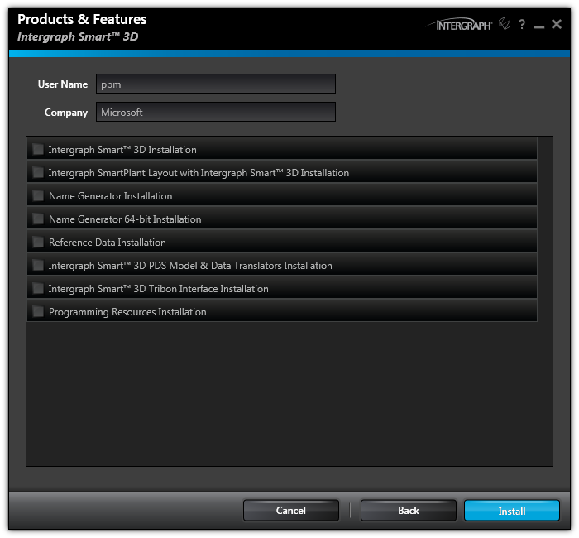
Smart 3D Setup: Splash screen

Slide 46
Smart 3D Setup
Reference Data installation

Slide 47
System Setup: Installation of Smart 3D Reference Data
Notes:
Provide User’s and Organization information
Read instruction, act accordingly
Optionally modify installation location (path)
Close Installation wizard (with option to review Smart 3D ReadMe document)

Slide 48
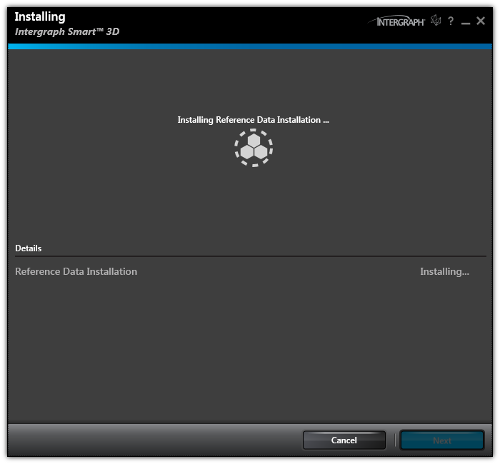
Smart 3D Setup: Reference Data
Notes:
Wait

Slide 49
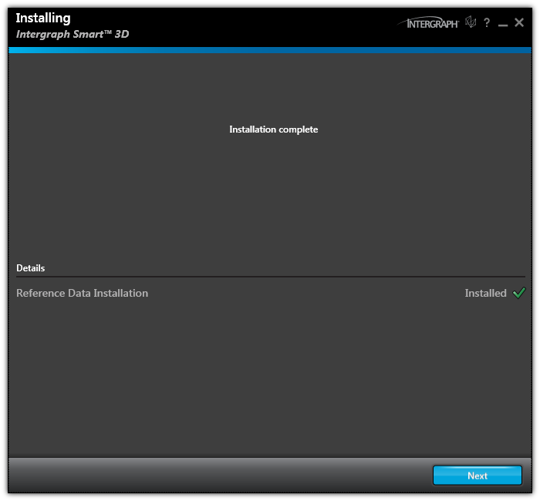
Smart 3D Setup: Reference Data
Notes:
Close Installation wizard (with option to review Smart 3D ReadMe document)

Slide 50
Smart 3D Setup
Name Generator installation
Configure extra MSDTC settings to allow remote clients and remote administration of COM+ applications

Slide 51
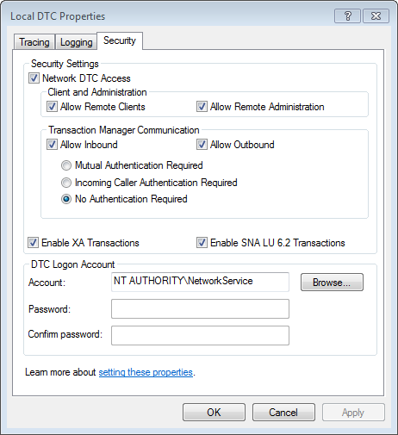
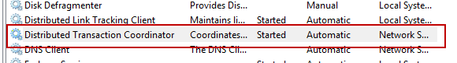
Smart 3D Setup
MSDTC Settings

Slide 52
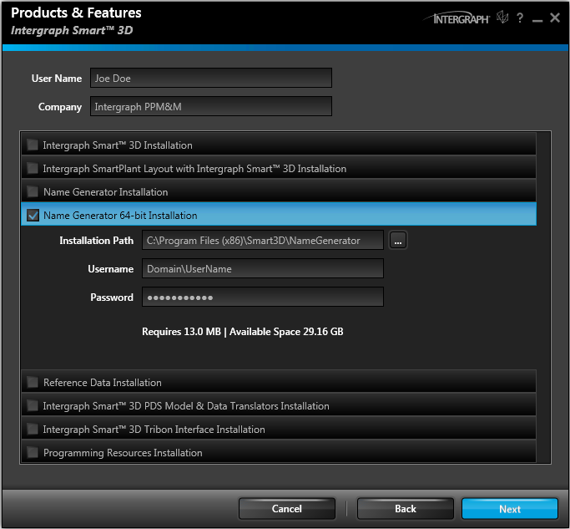
System Setup: Installation of Smart 3D Name Generator
Notes:
Provide User’s and Organization information
Read instruction, act accordingly
Optionally modify installation location (path)
Enter account and password for Name Generator
Close Installation wizard (with option to review Smart 3D ReadMe document)

Slide 53
Smart 3D Setup
Workstation Installation (Design and/or Admin Client)

Slide 54
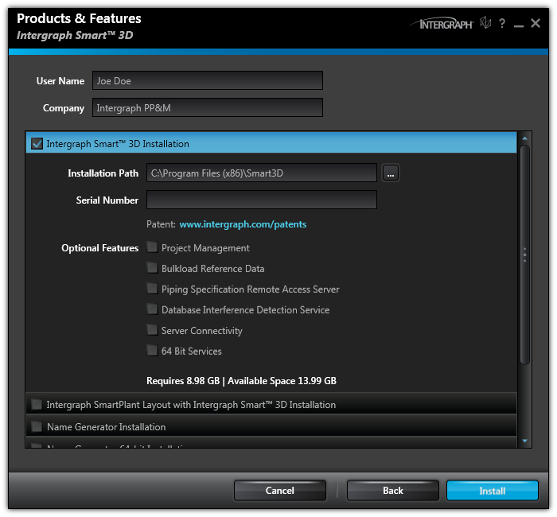
System Setup: Installation of Smart 3D Design Client Installation

Slide 55
System Setup: Installation of Smart 3D Design /Admin Client Installation
Notes:
Provide User’s and Organization information
Read instruction, act accordingly
Optionally modify installation location (path)
Close Installation wizard (with option to review Smart 3D ReadMe document)

Slide 56
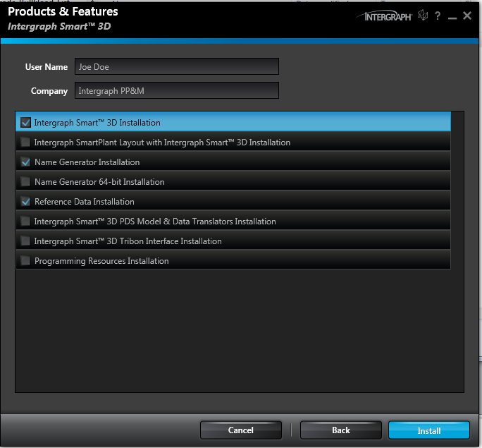
System Setup: Installation of Smart 3D Full Installation
Notes:
Provide User’s and Organization information
Read instruction, act accordingly
Optionally modify installation location (path)
Close Installation wizard (with option to review Smart 3D ReadMe document)

Slide 57
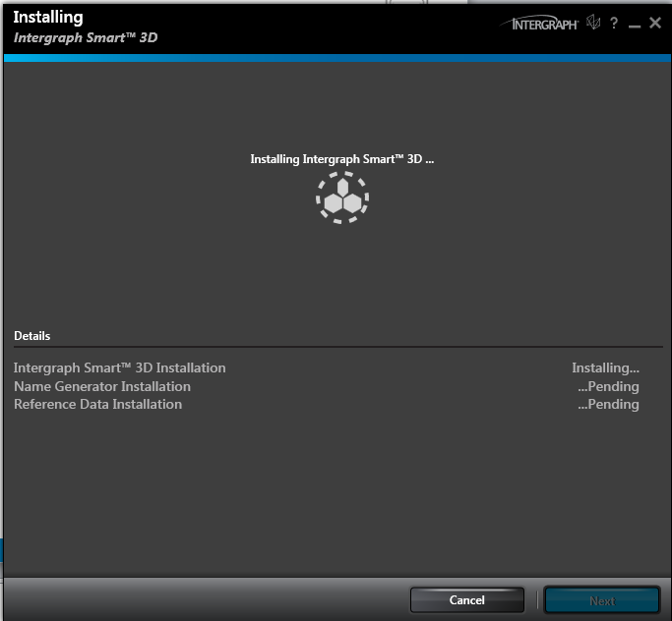
System Setup: Installation of Smart 3D Full Installation

Slide 58
Smart 3D Setup: HotFix installation
Installed through a GUI with similar options to base installation.
Can be installed silently with a script
HotFixes are listed as updates to Smart 3D in the list of programs.

Slide 59
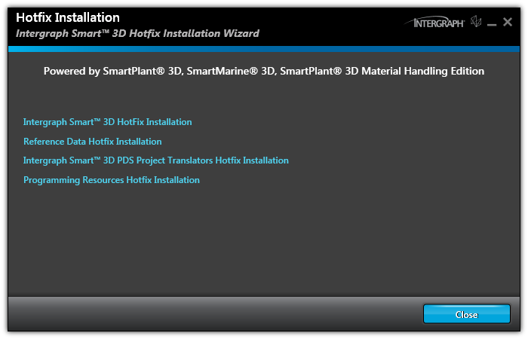
Smart 3D Setup: HotFix installation

Slide 60
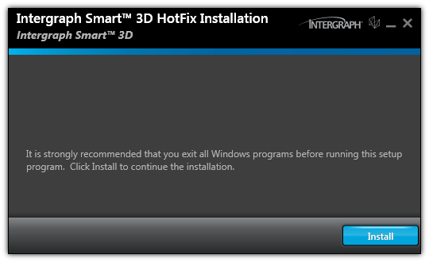
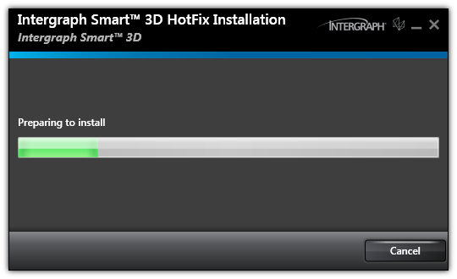
Smart 3D Setup: HotFix installation

Slide 61
Smart 3D Setup: Configurations
Final Configurations for a Workstation
Verify firewall is either turned off or set proper exceptions
Register SQL Server on administrative computers or configure the Oracle Net service

Slide 62
Smart 3D Setup: Configurations
Final Configurations for a Reference Data server
Share to the network and adjust proper permissions on the Shared Content folder.
Final Configurations for a Name Generator server
Set proper exceptions in the Windows Firewall to allow inbound requests on port 135 and the range of dynamic RPC ports
Add all Smart 3D users to the “Distributed COM Users group” local group

Slide 63
Project Setup

Slide 64
Project Setup: Hardware sizing recommendations
Hardware sizing, especially for servers, depends on many factors such as:
- The number of concurrent users per server
- The number of locations (Global Workshare)
- The size of the project (which translates into the size of the databases)
- Other software that is running on the machine
Notes:
64

Slide 65
Project Setup: Hardware sizing recommendations
The users per server that define the different project sizes (small, medium, and large) need to be taken as an effective number. The effective number of users should be calculated by taking into consideration the following:
Drawing Batch server - add 3 users
Remote IFC - add 1 user
Global Workshare Setup - For each server add 25% of the total concurrent users of all the other servers.
Ef = Cu + (0.25 * (Ct))
Where:
Ef = effective concurrent users for one server
Cu = concurrent users for this server
Ct = total concurrent users for all other servers
Notes:
65

Slide 66
Project Setup: Hardware sizing recommendations
Example:
In a Global Workshare project with 3 servers (locations), 40 users will connect to two servers, and 5 users will connect to one server:
Ef = Cu + (0.25 (Ct))
When all 3 servers are working concurrently, the equivalent number of users at each server is:
The equivalent number of users at each one of the 40-user servers are:
40 + (0.25 * (45)) = 51.25 users
The equivalent number of users at the 5-user server is:
5 + (0.25 * (80)) = 25 users.
Cu= 40
Global Worshare
Cu= 5
Cu= 40
Notes:
66

Slide 67
Project Setup: Hardware sizing recommendations
Project Size | Effective users on one server | Model database size | IFC Server | Batch Server
Small project | 1 to 15 | Up to 5 GB | Separate server or workstation | Separate server or workstation
Medium project | 16 to 50 | 6 – 20 GB | Separate server or workstation | One or more separate server or workstation
Large project | 51 to 100 | 20 GB or more | Separate server or workstation | Multiple separate servers or workstation
Notes:
67

Slide 68
Project Setup: Hardware sizing recommendations
Project Size | Small | Medium | Large
Number of processor cores (one Core 2 Duo counts as two) | 4 | 8 | 8 or more
Memory for SQL Server 2008 and Oracle 11g | 16 GB | 32 GB | 64+ GB
Bus Size, OS, and Database | 64 bit | 64 bit | 64 bit
Notes:
68

Slide 69
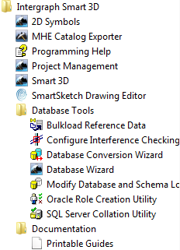
Project Setup: Familiarize with the software
Notes:
69

Slide 70
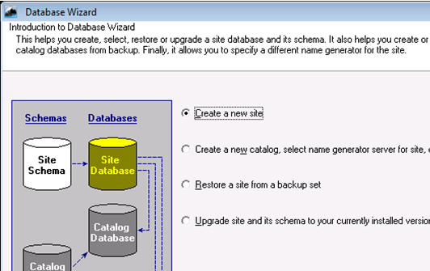
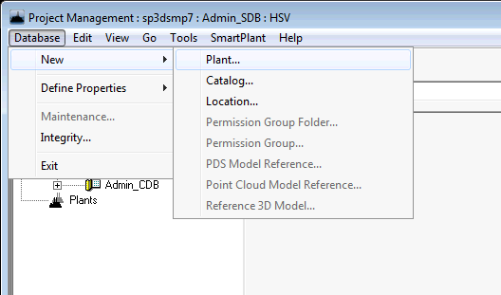
Project Setup: Database creation
Site and Catalog database creation
Database Wizard
Plant creation
Project Management

Slide 71
Project Setup: Create a plant from scratch
Site
Database Wizard AppRepos.dat/dmp
Site Schema
Catalog - Project Management AppRepos.dat/dmp
- Database Wizard CatalogDB.dat/dmp
Catalog Schema
Model
Reports Project Management
Reports Schema

Slide 72
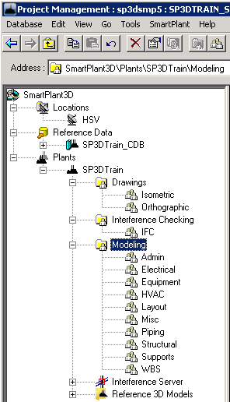
Project Setup: Permissions hierarchy
Plant/Catalog root
Top level item in the hierarchy
Permission Group Folder
A set used to organize permission groups
Permission Group
Portion of plant/catalog over which various people have various levels of access and responsibility

Slide 73
Project Setup: Permissions hierarchy
This hierarchy is seen only in Project Management
Can have unlimited number of levels of folders
Cannot have permission groups and permission group folders at the same level
Permission Groups are the last leaf in a branch
Copy/Paste permission groups available

Slide 74
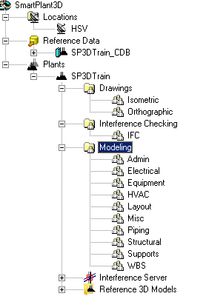
Project Setup: Sample Permission Objects hierarchy

Slide 75
Project Setup: Modify Permission Objects hierarchy
Rename command
Folders cannot be deleted if there are Permission Groups under them
Permission Groups containing objects cannot be deleted
Copy/Paste of Permission Groups and Folders copies just the Permission Objects, not model items contained within. Name has to be unique within container (Catalog or Plant).
Move command allow to relocate Permission Objects within Container

Slide 76
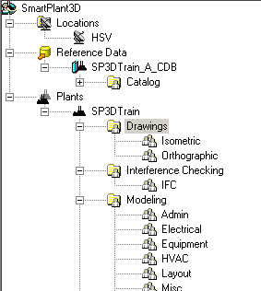
Project Setup: Root vs Permission Group assignment
Permissions can be granted for Windows Security Object (Groups and/or Users) at the Plant/Catalog Root and Permission Group level
Permissions granted at Plant/Catalog Root level allow access to modify permissions hierarchy within the plant and perform various administrative tasks.
Permissions granted at Permission Group level affect access to objects within that permission group. These are used for general modeling purposes.

Slide 77
Project Setup: Association concept
When objects are placed, they will be automatically assigned to a permission group.
Objects can be associated to systems belonging to permission group where user has access
Objects can only be modified or deleted if user has access to permission group assigned to the object.
You can associate objects to those Work Breakdown Structure (WBS) items to which you have access based on the permission group they belong to.

Slide 78
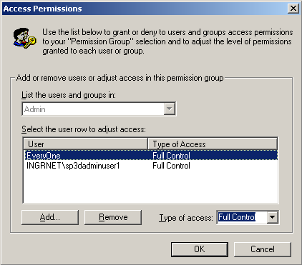
Project Setup: Permission access levels
Read = view objects
Write = create/modify/delete objects
Full Control = create/modify/delete + approve or reject objects

Slide 79
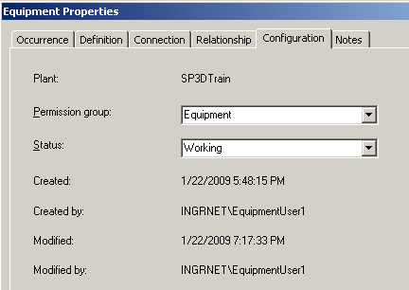
Project Setup: Object status
Working
Initial status of all objects; Objects can be edited/deleted while in this status
In Review
Object is in read-only mode and waiting for approval/rejection
Rejected
If an object is found to be incorrect, reviewer can send object to this status
Approved
If an object is found to be correct, reviewer can send object to this status

Slide 80
Project Setup: Status change based on permissions
Read
can’t change status
Write
can change from Working to InReview
can change from InReview to Working
can change from Rejected to Working
Full Control
can change from any status to any status

Slide 81
Project Setup: Permissions logical model
 | View | Create/Modify/ Delete | Send to review/ bring back | Approve/ reject
Read | √
Write | √ | √ | √
Full Control | √ | √ | √ | √

Slide 82
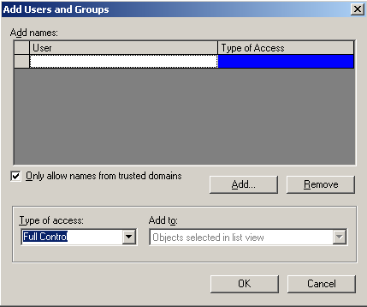
Project Setup: Add users to permission groups

Slide 83
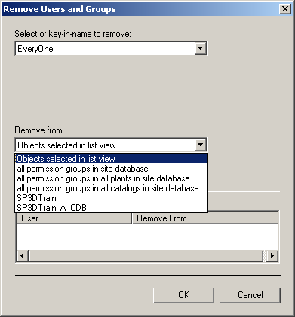
Project Setup: Remove users from permission groups
Select the users to be removed
Pick the places they need to be removed from

Slide 84
Setup and Administration Lab
Labs 1 - 3

Slide 85
Backup and Restore

Slide 86
Backup and Restore: Overview
Backup
Project Management Backup
Manual backup of the Shared Content folder
Restore options
Restore one or more plant databases from backup
Restore plant for selective recovery of model objects
Restore plant as a copy

Slide 87

Backup and Restore: Project Management Backup
Model Catalog and Site databases are backed up, reports databases are excluded.
A backup configuration file (bcf) containing information about the backup set is created in the location specified for the backup
Backup files will be saved to database server by default
Backups may be saved to a network location, additional configurations are required for this

Slide 88
Backup and Restore: Project Management Backup
There are no individual files to be backed up – only complete databases
To complete the backup set, user needs to manually backup the Shared Content folder for the plant
Multi-plant backup available
User running the backup as well as account used as logon for Oracle Windows NT Service need to have write permissions on the folder under which backup files will be created.

Slide 89
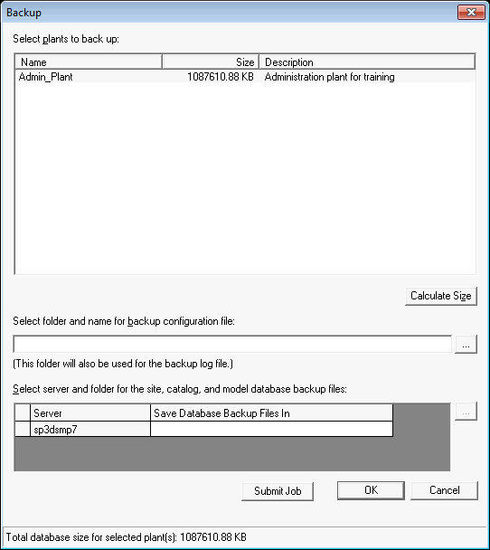
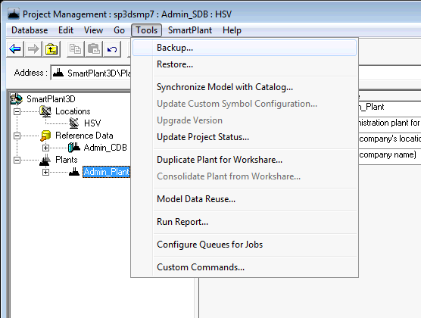
Backup and Restore: Project Management Backup

Slide 90
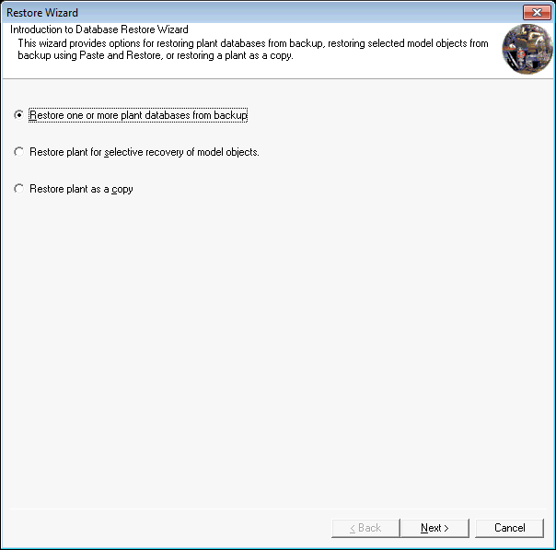
Backup and Restore: Restore options

Slide 91
Backup and Restore: Restore one or more plant databases from backup
Restores previously backed up plants overwriting the existing one.
You can only restore a complete plant (no partial restore)
Catalog can be overwritten or not depending on user selection to prompts
Items that were manually backed up (Shared Content folder) need to be manually restored as well

Slide 92
Backup and Restore: Restore plant for selective recovery of model objects
Restores a plant from a previous backup, without overwriting the existing plant.
Allows for selective recovery of objects from previous versions of the same Plant without losing object identity or relationships
The restored project will exist in the Site database in parallel to the current project and would share the same catalog.

Slide 93
Backup and Restore: Restore plant as a copy
Allows the restore of plants that were backed up from a different site database.
Allows to create a replica but independent plant from the production plant backup (test plants).
Ability to change the name of the plant and the restored model and catalog databases.
When the selected plant to restore is registered with SmartPlant Foundation, the registration is removed from the copy during the restore.

Slide 94
Backup and Restore: Off-site Restore
May be used to restore entire project on a new location, it can be due to a change in database servers, or to restore a backup received from a third party company.
Using database wizard, restore site from backup set
Using project management, restore plant from backup (this brings in catalog associated with the plant)
Regenerate report databases
Manually copy all the Shared Content files and outputs to the remote site
Custom symbol dlls need to be registered on each client workstation at the remote site if required

Slide 95
Setup and Administration Lab
Lab 4 – 7

Slide 96
Project Management: Delete a Plant
Full Control permission at the root level.
Option to drop or leave the physical database files in place.
For plants in Oracle, the software may not delete all of the associated database objects. To delete schema information after deleting an Oracle plant, you must use the Oracle Database Tools Wizard for Smart 3D located at [Product Directory]\ProjectMgmt\Tools\Bin\SP3DOracleDBToolsWizard.exe.
Notes:
96

Slide 97
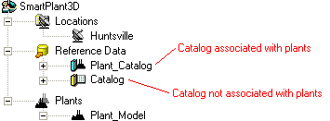
Project Management: Delete a Catalog
Catalogs can only be deleted if they are not associated with any plant.
In Oracle servers, Catalog must also be deleted using the Oracle Database Tools Wizard for Smart 3D
Notes:
97

Slide 98













Project Management: Hierarchy Icons
Top level of the hierarchy
Reference data
Catalog associated with a plant
Catalog associated with a plant. Missing database
Catalog associated with a plant. Needs to be upgraded
Catalog not associated with a plant
Catalog not associated with a plant. Missing database
Catalog not associated with a plant. Needs to be upgraded
Plant
Plant. Missing database
Plant. Needs to be upgraded
Permission group folder
Permission group
Notes:
98

Slide 99
Project Management: New Catalog Command
Create a new empty catalog or create a catalog from a template.
Default permission groups and access rules are created.
In a Global Workshare configuration, the Database > New > Catalog command is available at the Host location, but not at the Satellite locations.
Every catalog must be associated to a Shared Content folder
Notes:
99

Slide 100
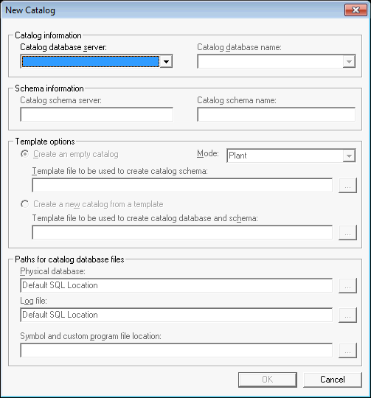
Project Management: New Catalog Command
Notes:
100

Slide 101
Custom Properties: Define Property Schema
Additional properties for plants, permission group folders and permission groups can be added
Properties can be viewed in project management environment but are also reportable
Property information for plants is stored in the site database to which they belong
Property information for permission folders and permission groups is stored in the plant to which they belong
Notes:
101

Slide 102
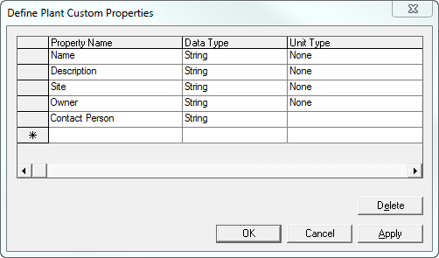
Custom Properties: Define plant property
Notes:
102

Slide 103
Setup and Administration Lab
Lab 8 – 10

Slide 104
Plant Organization (systems)

Slide 105
Systems and Specs: Contents
System hierarchy
Create and modify Systems hierarchy
Assign allowed specifications

Slide 106
Systems and Specs: Systems overview
A system is a container that group objects logically
Systems have other systems as children creating a hierarchy with unlimited levels
Subsystems can belong to a different permission group from their parent
Many different types of systems are supplied (discipline specific and generic)
Every object must belong to a system
Different types of objects can be associated with different system types

Slide 107
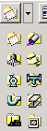
Systems and Specs: System types
Generic system
HVAC system
Equipment system
Pipeline system
Unit system
Conduit system
Electrical system
Piping system
Structural system
Area system

Slide 108
Systems and Specs: Create and modify Systems hierarchy
Create new System commands
Copy and paste of Systems
Importing from excel

Slide 109
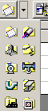
Systems and Specs: Create new System commands
Creates a system as a child of the currently selected system
Currently active name rule for the system type being created is used to generate the name
If currently active name rule is ‘User-defined’, you can enter the name during creation
Systems and specifications task – Dedicated function

Slide 110
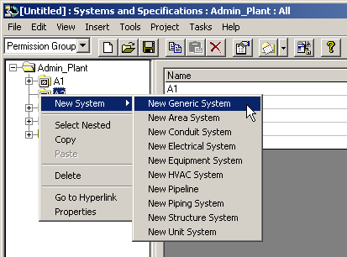
Systems and Specs: Create new System commands
Systems can be created from workspace explorer hierarchy.
Systems and specifications task - Contextual menu

Slide 111
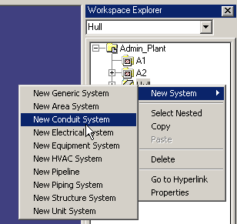
Systems and Specs: Create new System commands
Systems can be created from workspace explorer hierarchy.
Graphical tasks

Slide 112
Systems and Specs: Copy and paste of Systems
Systems can be copied in Systems and Specification task or in the Workspace Explorer
To select the entire hierarchy under a system, right-click the system then choose option “select nested”
Paste the hierarchy where desired (paste dialog box may appear)
You can copy and paste system hierarchies between two plants in that exists in the same site database

Slide 113
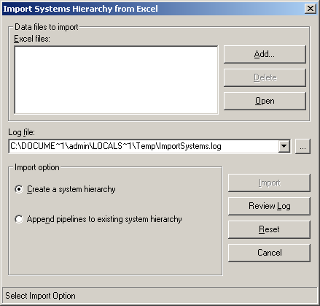
Systems and Specs: Importing from excel
You can create an entire systems hierarchy or add pipelines to an existing hierarchy using a Excel workbook
Allowed specifications for pipelines can also be set in the workbook.
If specifications are allowed to pipelines in the workbook, these pipelines will not automatically inherit specifications allowed at parent levels including the root.

Slide 114
Systems and Specs: Editing Systems
Deleting Systems
Renaming Systems
User defined
Default naming rule
Moving Systems
Move using system’s properties page
Move using drag and drop in the Systems and Specification task

Slide 115
Systems and Specs: Allow specifications
Specifications limit part selection and placement based on rules.
By default, specifications are defined in the Catalog and must first be allowed to the Plant
All systems inherit the specifications allowed at the Plant root node, unless specifications were allowed from import command.
Each system must be allowed at least one specification

Slide 116
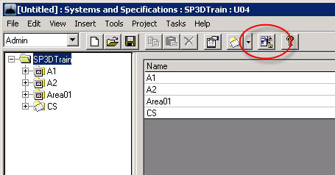
Systems and Specs: Define allowed specifications
Systems and Specifications task

Slide 117
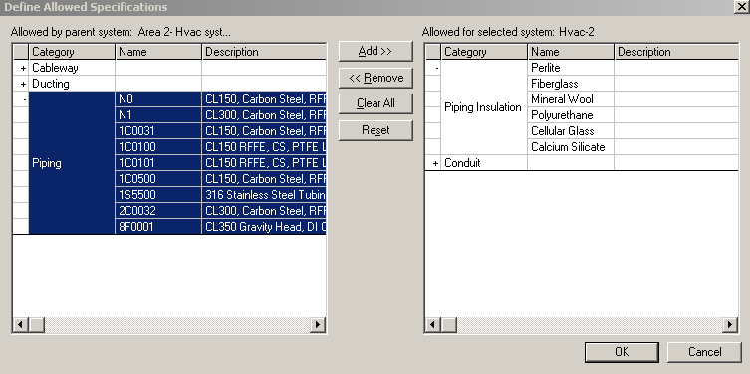
Systems and Specs: Define allowed specifications
Whole categories can be selected with a single click
Notes:
117

Slide 118
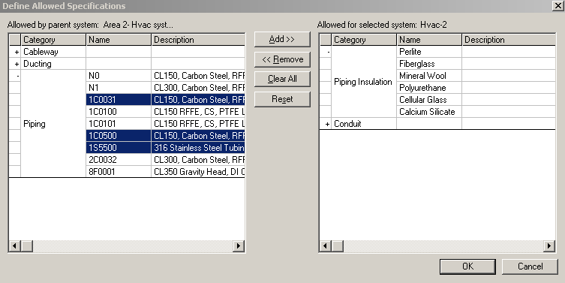
Systems and Specs: Define allowed specifications
Multi-selection of specifications and/or categories
Notes:
118

Slide 119
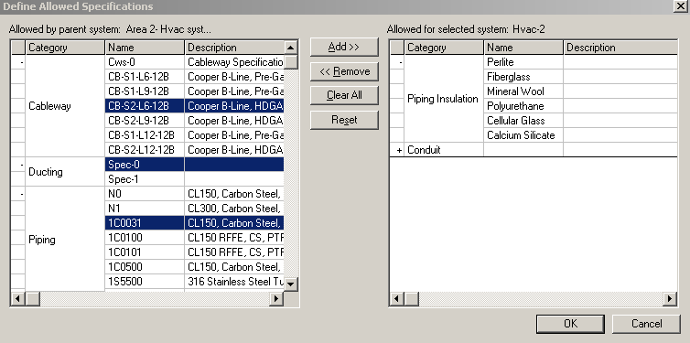
Systems and Specs: Define allowed specifications
Multi-select of specifications from different categories
Notes:
119

Slide 120
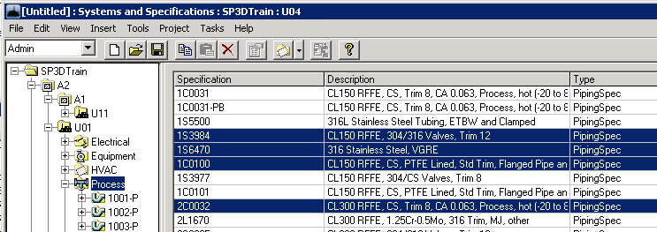
Systems and Specs: Define allowed specifications
Easier method to remove allowable specifications from a system
Switch to the specifications tab while browsing the systems hierarchy
Multi-select specifications and press delete button from ribbon bar
Notes:
120
In the systems and specs environment, rename command should be available on the right-click menu in the tree view and on the Edit menu.
Allow multi-select of systems in the tree view for copy/paste & delete

Slide 121
Setup and Administration Lab
Lab 11 - 14
Notes:
121

Slide 122
Common Applications

Slide 123
Optimization for Roles

Slide 124
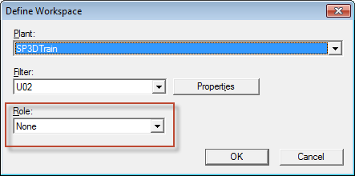
Optimization for Roles
Used to refine Workspace definition filter
Roles are defined in delivered OptimizationforRoles.xml
Location: \\Server\SharedContent\XML
Each role is defined with a set of disciplines and subclass object types

Slide 125
default COLOR CONFIGURATION

Slide 126
Default Color Configuration – The basics
Project Management command
Import
Export
Configure Default Colors
Apply Default Colors

Slide 127
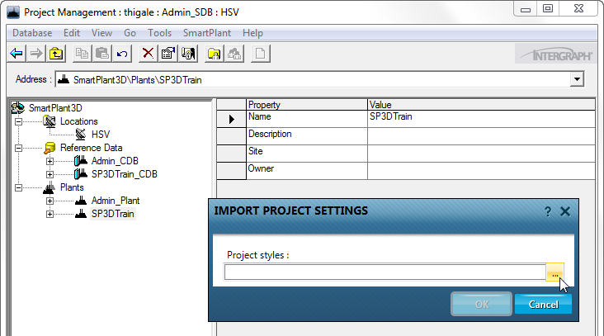
Default Color Configuration
Import
Aids in importing a set of “Default Style” rules into a model database
Used for porting rules from one model to another
Intergraph Defaults are available in SharedContent/XML folder

Slide 128
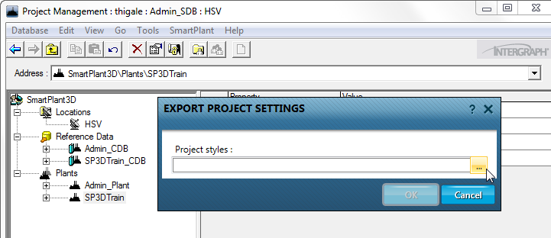
Default Color Configuration
Export
Aids in exporting the “Default Style” rules from a model to be ported to another model

Slide 129
Default Color Configuration
Configure Default Colors
Styles (colors) are applied per object type
Rules define the style applied to object types
Granular level of coloring based on object properties
Color by Role makes it possible to define different colors for same object type based on role (workspace simplification role) of the person using it.

Slide 130

Default Color Configuration
Configure Default Colors

Slide 131

Default Color Configuration
Configure Default Colors
Create a rule

Slide 132

Default Color Configuration
Configure Default Colors
Create a rule

Slide 133

Default Color Configuration
Configure Default Colors
Define criteria

Slide 134

Default Color Configuration
Apply Default Colors
New Default Color Rules are applied to new or modified objects automatically
Apply Default Colors to change appearance of existing objects in the model
This is a time consuming process and shall be sparsely used

Slide 135
Default Color Configuration
Considerations
New rules are automatically applied only to new or modified objects
Colors by default symbology rules are applied only to the simple physical aspect
Default colors may be used for colors such as object type or fluid code which are not expected to change through the life of the project, SSRs should be used for setting colors based on properties which change as project progresses such as approval status
2014 R1 has applied default colors to insulation (translucent white), maintenance and operation aspects (translucent red) but SSRs may be used to apply other colors to aspects
Avoid testing on production models, time to apply default colors can impact testing time - use a model which has one occurrence of each object type for ease of testing

Slide 136
Default Color Configuration
Considerations
Colors are not consistently applied on session files created prior to applying changes. New session files are recommended after making new rules.
When using default colors by Role, the colors will not be dynamically updated for saved sessions. New session files need to be created.
Colors will not change automatically to Intergraph's new color scheme after a version upgrade of existing models, however new models created with 2014R1 will automatically apply the DefaultSymbologyRules.xml file from SharedContent/xml folder
Coloring equipment by classification will take care of equipment, components and shapes but for nozzles, edges available on SmartSupport may need be used to select nozzles with specific classification and apply default colors to them

Slide 137
Default Color Configuration
Considerations
Colors with the ‘Default’ role are automatically applied to SPR session exported from the S3D session, further overrides may be applied using property page for 3D Model Data or ReportSettings.txt for SPR Direct

Slide 138
Setup and Administration Lab
Lab 15-17
Notes:
138

Slide 139
Model Data Reuse (MDR)
Notes:
139

Slide 140
Model Data Reuse: Introduction
Model Data Reuse (MDR) is a way to copy large amounts of 3D model data in a robust, scalable and intelligent way
MDR supplements the current copy/paste process – the existing process remains in place for smaller sets of data

Slide 141

Model Data Reuse: Results

Slide 142
Model Data Reuse: Advantages
MDR runs from Project Management environment as a wizard
Interaction with objects is not required
Does not require objects to be loaded into memory
process is scalable and can copy much larger sets of data
Software breaks down copy set into multiple transactions
Process is robust and can tolerate a failure; it will continue to copy the rest of the remaining objects

Slide 143
Model Data Reuse: Advantages
Software determines the sequence in which to copy objects
Permission group mapping to existing or default permission group
Transformation can be chosen using coordinate systems
Very good logging of process (including failures)
Copy of model objects between plants is supported
Re-startable process

Slide 144

Model Data Reuse
MDR command exists only in Project Management

Slide 145
Model Data Reuse Workflow
Restart an Operation
Select source objects based on systems
Begin Model Data Reuse
Select disciplines to be copied (optionally WBS, Assemblies, Volume, Drawings)
Start a New Operation
Select source objects based on filters
Select destination plant and system (optionally map PGs)
Select a transformation
Confirm copy and review results

Slide 146

Model Data Reuse
The Model Data Reuse command invokes a wizard which allows you to complete the copy operation

Slide 147
Model Data Reuse: Restart Operation
If the restart operation is selected then the user gets a list of all operations and their status.
Possible statuses:
Stopped: Process terminated in an orderly way (User clicked stop on the progress button).
Incomplete: Process terminated abnormally (Hardware/Software failure on client machine).
In Progress: Operation is restarted on a different client machine.
Completed: Operation completed successfully.

Slide 148
Setup and Administration Lab
Lab 18 - 20
Notes:
148

Slide 149
Synchronization

Slide 150
Synchronize Model with Catalog
Used to propagate changes from the catalog to the model (including property, specification, and symbol changes)
CDB
MDB

Slide 151
Synchronize Model with Catalog
The model database is updated to include the following changes:
Modifications to properties that have been bulkloaded into the catalog.
Modifications to name rules.
parts that have been deleted from the Catalog are added to the To Do List.

Slide 152
Synchronize Model with Catalog
Actions performed by the Synchronization command will depend on the level of access of the user running the command from Project Management:
User with write access to model objects:
Extended execution time
Model objects will be updated automatically with no user interaction
User with read access to model objects:
Reduced execution time
Objects will not be updated automatically (ToDo list entries will be created)

Slide 153

Synchronize Model with Catalog

Slide 154
Database Maintenance Command

Slide 155

Database Maintenance Command
Provides a tool to purge temporary data that may cause performance issues.

Slide 156
Database Maintenance Command
Delete temporary symbol variations (flavors) in database
These are temporary symbol variations that the software used during creation or placement of certain symbols.
Delete records of objects that users have deleted from model
Rebuild selected indexes
Reorganize selected indexes

Slide 157
Database Integrity

Slide 158
Database Integrity: Overview
Database integrity problems are issues of the modeled objects that can in some circumstances prevent modeling activities or impact the accuracy of deliverables such as drawings or reports.
A typical example of a database integrity issue is an object that exists without a mandatory relation to another object in the model.

Slide 159
Database Integrity: Overview
Important
These errors are not expected. However, in the event that they occur, you can correct them by perfoming the database integrity workflow in which objects will be addressed
We strongly recommend that you check the databases from time to time and promptly report any unknown problems to Intergraph.
If you receive a database integrity error that is not listed in documentation, contact Intergraph Process, Power & Marine Support.

Slide 160
Database Integrity: Workflow
The workflow to address database integrity issues have three overall steps:
1. Execute database integrity from Project Management.
2. Generate a report to review issues found.
3. Run Clean database command to address problems.

Slide 161

Database Integrity: Execute Database Integrity
Execute database integrity from Project Management
Check Database Integrity runs directly on a database (Site, Catalog, or Model), and creates records for the objects that need to be cleaned. Once the database has been scanned for errors, you can generate a report to review the errors that the Check Database Integrity command generated.
You can run this command multiple times:
To check the database for objects with integrity problems
To confirm that objects have been deleted or cleaned (second pass)

Slide 162

Database Integrity: Generate reports
Generate a report to review issues found
The software includes various report templates intended for diagnosing database integrity issues. You can run these report templates by opening a session in the software and clicking Run Report command from the Tools menu. Report templates are located in the Catalog Reports tab then under Report > Types of Reports > Diagnostics node. Select any of the four following reports:
Diagnostic clean database issues
Diagnostic clean database issues grouped by problem description
Diagnostic clean database issues grouped by status
Diagnostic clean database issues with column filters

Slide 163

Database Integrity: Generate reports
DataStore Displays whether the problem exists in the model or Catalog database.
Problem Description Provides a brief explanation of the issue. Use it to search more details in DBIntegrity.pdf guide
Status Determines if the issue is new, existing or resolved
Severity Fatal, Crucial, High, or Normal
Action to Take Describes what to do to fix the problem. Possible values include No Action, To Be Removed or To Be Repaired.
If the action is To Be Repaired, you should run Clean Database custom command.

Slide 164
Database Integrity: Run clean database command
Run Clean database command to address problems.
Consult latest DBIntegrity.pdf document for the correct workflow to fix the problem.
Most workflows involve use of the Clean Database custom command
Action to take = To Be Repaired

Slide 165
Database Integrity: Run clean database command (Cont´d)
Clean Database Custom Command
SP3DCleanDatabaseCmd.CCheckObj

Slide 166
Setup and Administration Lab
Lab 21 - 23
Notes:
166

Slide 167
PDS Model Reference

Slide 168
PDS Model Reference: Overview
Prerequisites
Configuration steps
PDS Object Filters

Slide 169
PDS Model Reference: Prerequisites
Before installing PDS Data Access component, you must install the following prerequisite software on a computer on which the Project Management and Smart 3D Server Connectivity options are also installed:
Batch Services
PD_Shell (Plant Design System Environment)
RIS Client
PDS Data Access Components (Smart 3D Installation CD)

Slide 170
PDS Model Reference: Configuration steps
From Workstation machine with Project Management component installed:
Point PDS Configure to appropriate pds.cmd file
Point RIS Schema Manager to PDS schema file
In Project Management, attach the PDS project to SP3D plant using New PDS Model Reference command

Slide 171


PDS Model Reference: Configuration steps

Slide 172

PDS Model Reference: Configuration steps

Slide 173

PDS Model Reference: Configuration steps

Slide 174
Point cloud model reference

Slide 175
Point cloud reference

Slide 176
Point cloud reference
Smart 3D provides vendor-neutral point cloud data integration within the Plant modeling software environment.
Saves redrawing an object, while still being able to add to it or build on top of it.

Slide 177
Point cloud reference: Supported point cloud vendors
Leica Geosystems
Quantapoint
Trimble
Z+F UK

Slide 178
Point cloud reference: Possible actions
Accessing Point Cloud (Accessories menu, filters)
Selecting a Data Point
Measuring
Interference Checking (IFC)

Slide 179

Point cloud reference: Attach Point Cloud to plant
Right click the plant in Project Management
Select New Point Cloud Model Reference.
Select a vendor from the Select Point Cloud vendor to use list.

Slide 180
Point cloud reference: Detach Point Cloud from plant
Right click the plant in Project Management
Select “New Point Cloud Model Reference”.
Select “None” from the list of vendors to use.

Slide 181
Error log and memory monitor

Slide 182
Error Log & Memory monitor
Error Log
On by default, but needs to be set for persistence (cleared when session closes)
.Activate using …\Core\Tools\Administrator\Bin\ErrorLogEnable.exe
4 Severity levels
Time-based log file names
Error log created per session or instance
Memory monitor
Reports memory usage for all active Smart 3D sessions
Different reporting states (Warning, Critical)
Notes:
182

Slide 183

Error Log & Memory monitor

Slide 184


Error Log & Memory monitor

Slide 185
Setup and Administration Lab
Lab 25

Slide 186
Interference Checking (IFC)

Slide 187
Interference Checking Detection (IFC): Overview
Smart 3D provides two methods for IFC operation:
Server-based Interference checking (database detection).
- Runs on a separate server as a Windows NT Service
- Looks for all interferences in the plant
Interactive interference checking (local detection).
- Helps the designer in real time
- Results are scoped to objects in a session (what you see in your workspace)

Slide 188
IFC: Characteristics
Database Detect | Local Detect
Runs continuously (System Administrator choice) | Works only within the current session
Dedicated server minimizes impact on users and improves performance | Provides immediate graphical feedback (works immediately after commit)
Creates persistent interferences that are stored in the model database | Creates temporary interference markers in a user session
Based on administrator settings (controlled by permission groups) | Based on individual user settings
Provides feed back on how much has been checked | Checks only created and modified items

Slide 189

IFC: Visual differences
Any interference detected by the server based detection method appear as a sphere
Interferences detected by local based detection method appear as a box

Slide 190



IFC: Visual differences
Hard clash
Soft clash
Clearance clash

Slide 191
IFC: Aspects
Aspect: Geometric area or space related to an object, such as its physical shape or the space required around the object.
Aspects are defined when a part class is created for the reference data.
Aspects can represent clearances for safety or maintenance areas.

Slide 192

IFC: Aspects
Simple Physical
Detailed Physical
Insulation
Operation
Maintenance
Reference Geometry
Centerline

Slide 193

IFC: Configuration

Slide 194
IFC: Configuration – checking priority
Three types of checking priorities (based on object aspects):
Required - Produces a Hard type of clash
Optional - Produces a Soft type of clash
Not Checked - Elements currently displayed in this aspect will not be checked for interferences

Slide 195
IFC: Configuration – comparison criteria
IFC can process the following combination of objects based on their checking priorities:
Required – Required (Hard – Hard)
Required – Optional (Hard – Soft)
Optional – Optional (Soft – Soft)

Slide 196
IFC: Configuration – Clearance rule
Clearance rules define the minimum distance between any two objects

Slide 197



IFC: Configuration – Clearance rule

Slide 198
IFC: Configuration – Permission group
All markers representing clashes or clearances will be assigned to a permission group

Slide 199
IFC: Configuration – Marker size
Too small and markers may not be visible enough
Too big and marker itself may hide the object generating the clash

Slide 200
IFC: Local detection
IFC local detection is available from all tasks in a session (Tools → Check Interference)
Very simple and intuitive GUI
Ribbon bar includes:
Settings
Visualization
Review & approval commands

Slide 201
IFC: Local detection
Local detection toolbar
Settings
Hide Interferences
Fit on Interferences
Close Toolbar
Show Interf.
Refresh R3D Interferences
List view

Slide 202

IFC: Local detection

Slide 203

IFC: Local detection – List view
Show interferences currently displayed in the workspace
Updates automatically
Sort by any column

Slide 204
IFC: Database detection
Verify permission requirements (one time)
Configure interference service properties
Start interference detection Windows NT Service
Create IFC permission group folder and permission group (one time)
Start database interference detection process

Slide 205
IFC: Database detection
Verify permission requirements (one time)
For the interference database detection process to run correctly, user setting up IFC must meet permission requirements according to the following guidelines:
SmartPlant 3D user permissions:
Full Control access at the root of the plant is required to start/stop IFC Process
Write access or higher to the designated IFC permission group
IFC Windows NT Service login permissions:
Identity for the service must be a domain account that has Write or higher level of access to the designated permission group for IFC. If possible use login with a password not required to change as often as a corporate user account.
User needs at least Read access on SharedContent folder

Slide 206


IFC: Database detection
Configure interference service properties

Slide 207


IFC: Database detection
Start interference detection Windows Service

Slide 208

IFC: Database detection
Create IFC permission group folder and permission group (one time)

Slide 209
IFC: Database detection
Start database interference detection process

Slide 210

IFC: Database detect
Modifications to Database Interference properties
If any change to settings on IFC properties form is to be done at any time during the life of the project, all objects in the plant need to be reprocessed from the beginning (0% to 100%).
Notes:
210

Slide 211
Setup and Administration Lab
Lab 26

Slide 212
Reference 3D (R3D)

Slide 213
Reference 3D: Overview
Reference 3D (R3D) functionality facilitates the attachment of external 3D data as a reference model.
Such external data might have been published from another Smart 3D model or from a third-party model such as PDMS.
The data from external models is expected as a set of graphic (.zvf) and data (.xml or .drv) files.

Slide 214



Reference 3D: Concept
.ZVF
.XML

Slide 215
Reference 3D: Functionality
With Reference 3D you can do the following:
Attach and orient (position, rotate, and scale) the reference model relative to the active model so that you can view the R3D data graphically and model against it.
Control (add) R3D objects, hierarchy, and properties with user-defined schema and mapping files to extend the delivered R3D schema.
Inspect the R3D model objects' properties and view their names through ToolTips.
Use a powerful Smart 3D filtering mechanism on R3D Objects to filter objects from Reference 3D Models based on their type—regardless of the authoring tool used for creation (SP3D, SM3D PDMS, and so on).
Extract simple General Arrangement drawings showing relative positioning of objects from R3D models, with limited annotation.

Slide 216

Reference 3D: Transformation overview
N
150 m
100 m
O
E
90°
200 m
-125 m

Slide 217
Reference 3D: Attaching Smart3D Models
.ZVF
.XML
Publish Data
Attach as R3D Model
Source Model
Target Model

Slide 218



Reference 3D: Attaching PDMS Models
.RVM
.ATT
Export RVM
Translate Data
PDMS
.ZVF
.DRV
Smart 3D
Attach as R3D Model

Slide 219

Reference 3D: Filters
R3D includes a very powerful filtering mechanism that allows you to filter objects from references based on their type, regardless of the authoring tool used for creation (Smart 3D, PDMS, and so on).

Slide 220
Reference 3D: Business cases
Some of the business cases provided by this functionality include:
Supporting disconnected workshare
Preserving intellectual property in joint venture projects
Allowing for better security in joint venture projects
Compatibility between datasets from different S3D versions
Bridging differences between S3D datasets on disparate databases (Oracle vs SQL)
Ability to work with datasets from external tools such as PDMS, XMpLant
Support parallel design for increased productivity

Slide 221
Reference 3D: Business cases
Some of the business cases provided by this functionality include:
Supporting Disconnected Workshare
Since the data is published to files at the source location(s) and attached as a reference at the target location, live connection between the databases is not required.
Periodic publish and update of the R3D models would allow multiple partners to work on a joint venture product in a disconnected manner.

Slide 222




Reference 3D: Business cases – disconnected workshare
Publish
Update
Attach
Sub Contractor
(Source Model)
Prime Contractor
(Target Model)

Slide 223
Reference 3D: Business cases
Some of the business cases provided by this functionality include:
Supporting Parallel Design for Increased Productivity
If a project has many similar units, only one unit may be modeled and published. This published unit can then be attached multiple times with the required positioning.
Additional modeling such as civil work can be performed simultaneously
Model Data Reuse functionality can be used to actually replicate unit across to obtain real S3D objects

Slide 224
Reference 3D: SPRDirect Output
Allows to publish Smart 3D reference objects (DGN/DWG, PDS) to Graphic (VUE) and label data (MDB2) files
Files can be opened in SmartPlant Review or using Reference 3D.
Easier and Faster way to get Smart 3D project to SPR where you can interactively review and analyze 3D model data.

Slide 225


Reference 3D: Attaching SPRDirect Data
.VUE
.MDB2
SPRDirect Output
Translate Data
.ZVF
.MDB2
Attach as R3D Model

Slide 226

Reference 3D: Convert to ZVF
ConvertToZVF.exe utility is delivered out of the box and can be found at the following location;
..\Core\Tools\Administrator\Bin\

Slide 227


Reference 3D: Create Folder Hierarchy
If there is folder hierarchy on disk below the root folder of the R3D attachment, this folder hierarchy is automatically reflected in the WSE without having to do anything extra in S3D
Hide and show command works at any level in this hierarchy in WSE to quickly hide and show the graphics in that branch

Slide 228


Reference 3D: Levels and Layers
The properties page of the R3D model, folder or file shows the levels or layers and display can be turned on or off using check boxes.
Surface style rules can be created based on Levels and Layers in the R3D model which can be exported to SP Review.
Filters can be defined based on Levels and Layers.
Surface style rules can be created based on these filters which can be exported to SP Review.

Slide 229
Setup and Administration Lab
Lab 27 - 31

Slide 230
Intergraph Batch Services

Slide 231
Batch Services
This functionality allows scheduling of regular, time consuming tasks through the Intergraph Batch Services application.
Database Integrity Command
Backup Command
Restore Command
Structural import
Structural export
Drawings and Reports update
Printing drawings
Updating multiple R3D models

Slide 232
Setup and Administration Lab
Lab 33 - 36

Slide 233
Database conversion wizard (SQL ORACLE)

Slide 234
Database Conversion Wizard : Overview
Used to convert databases from SQL Oracle
Prerequisites:
- SQL and Oracle databases should be running.
- Client machine needs SQL server registered and TNSNames entry for Oracle instance.
This tool is only supported for Smart 3D databases (Plant mode).

Slide 235

Database Conversion Wizard

Slide 236

Database Conversion Wizard

Slide 237
Convert database mode ( Plant to marine or MHE)

Slide 238
Convert Database mode
Can be used to convert Plant database to Marine or MHE
Currently only used for MSSQL databases.
ConvertDatabaseMode.exe
Location: InstallDir\Smart3D\Core\Container\Bin\Assemblies\Release
Help guide ‘Smart3D2014R1_Plant_Marine_MHE_Conversion.pdf’

Slide 239

Convert Database mode

Slide 240
Adding user defined attribute to s3d database

Slide 241

Adding User Defined Attribute to S3D Objects
A typical project requirement can be to have a common user attribute to S3D objects. This attribute needs to be bulkloaded into the S3D catalog.

Slide 242
Adding approval status in s3d

Slide 243

Adding Approval Status in S3D
Project administrators would like to add new approval reasons for S3D objects. These could be bulkloaded to the catalog using a codelist.

Slide 244
Setup and Administration Lab
Lab 35 - 37

Slide 245
Plant version upgrade

Slide 246
Plant version upgrade: Overview
Database upgrades are required whenever there is a major change of software version (example from V2009.1 to V2011 SP1)
Smart3D 2014R1 supports upgrade from following versions:
- 2011SP1
- 2011R1
- 2014
It is only possible to upgrade a plant configuration using the same database type (Oracle to Oracle or SQL to SQL).

Slide 247
Plant version upgrade: Workflow
Backup plant and symbols
Verify integrity of data
Verify/clean specifications
Synchronize model with catalog
Resolve To-Do list
Verify access to reference files
Run database integrity and clean corrupted elements
Final backup with old version
Install latest software to server and workstation machines

Slide 248
Plant version upgrade: Workflow
Upgrade Site and Site schema databases using Database Wizard.
Upgrade Catalog and Catalog schema databases using Tools > Upgrade Version command from Project Management.
Upgrade Model database using Tools > Upgrade Version command from Project Management.

Slide 249
Plant version upgrade: Workflow
Upgrade SharedContent
Upgrade reference data
Customized catalogs
Non-Customized catalogs
Customized drawings and reports
Synchronize upgraded model with upgraded catalog and resolve pending To Do list actions.
Run database integrity and correct possible issues
Regenerate reports database

Slide 250
SMART 3D AUTOMATIOn TOOLKIT

Slide 251

Smart 3D Automation Toolkit
Tool is available on Intergraph® Smart Support site (Previously known as eCustomer site)
Tutorial and Videos are available to download on same site.
Installation is easy and is compatible with all Smart 3D versions
Toolbar can be accessed by tapping Shift key thrice (Shift-Shift-Shift)

Slide 252




Smart 3D Automation Toolkit (Contd..)
Common Commands used for administrative workflows:
- Select Set browser
- Export styles, Style Rules and filters
- Import styles, Style Rules and filters
- Filter options

